Slide 1
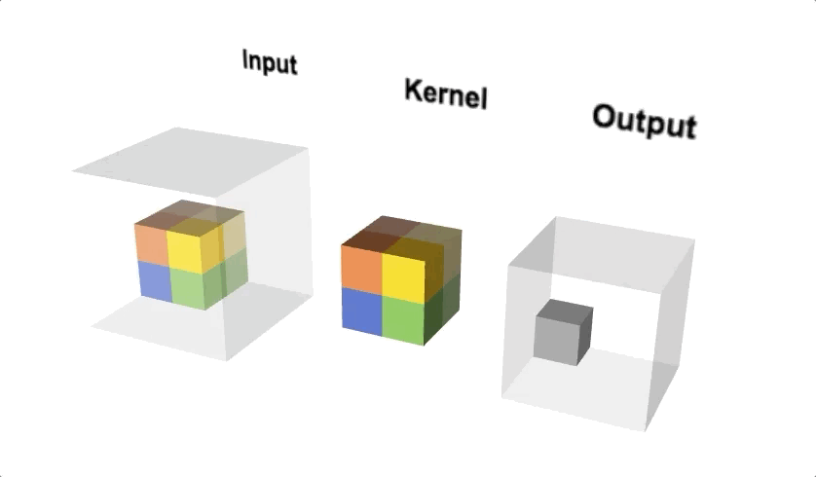
Convolution 3D
3D input
Usually input as video
Collection of 2D images
< https://medium.com/apache-mxnet/1d-3d-convolutions-explained-with-ms-excel-5f88c0f35941 >

Slide 2
Data
State
State[# of UE][# of AP][# of mode]
Mode[] = { 0: connection, 1: resource, 2: bitrate }
Action
Use bitmask
Ex)
103240 x 402130
AP selection
Bitrate selection
Notes:
Action은 bitmask 사용이 적합

Slide 3
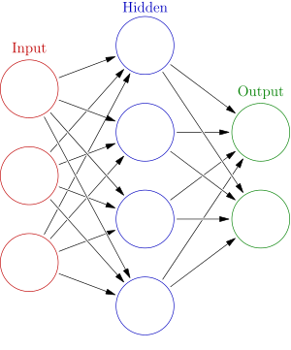
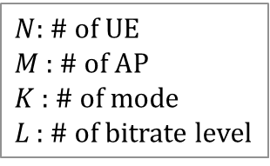
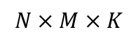
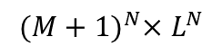
Neural Network
Initiation
$N$: # of UE
$M$ : # of AP
$K$ : # of mode
$L$ : # of bitrate level
State
action
$$N×M×K$$
$${(M+1)}^{N}×L^{N}$$
# of State << # of Action
< https://ko.wikipedia.org/wiki/인공_신경망 >

Slide 4


Problem
Resource
When connection was not set
Notes:
Action은 bitmask 사용이 적합

